Slide 1
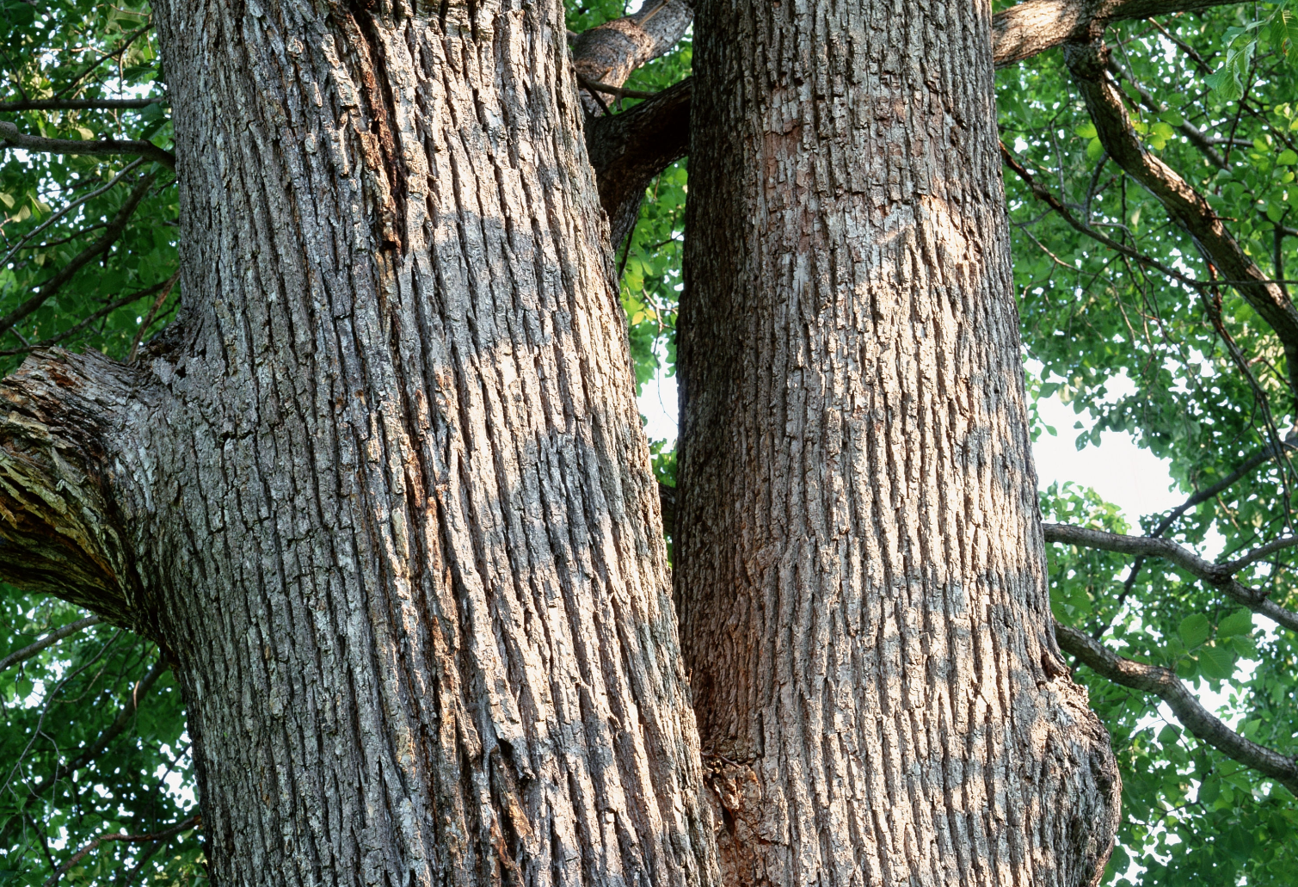
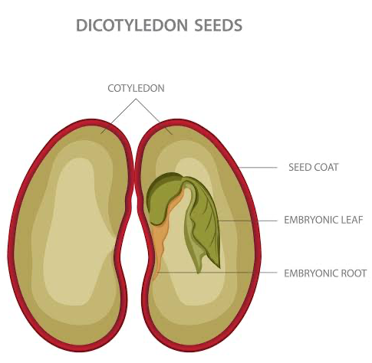
Paleobotanical Evidence for High Altitudes in Nevada During the Miocene
Henry Zhou, 2024
Jack A. Wolfe,* Howard E. Schorn, Chris E. Forest, Peter Molnar
Woody dicotyledons
Notes:
Stem are woody
Start from the method and lead to the conclusion
Materials they use

Slide 2
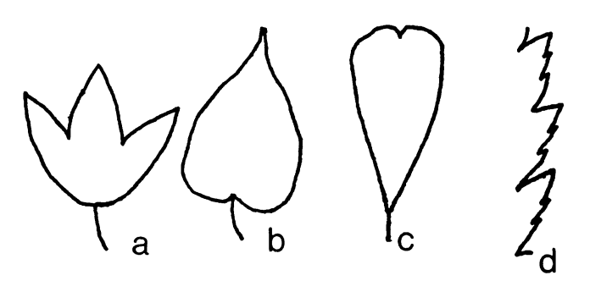
Working flow
1
Environment parameters:
mean annual temperature
specific humidity
enthalpy
Wolfe, 1995
2
3
Paleo-elevation

Slide 3
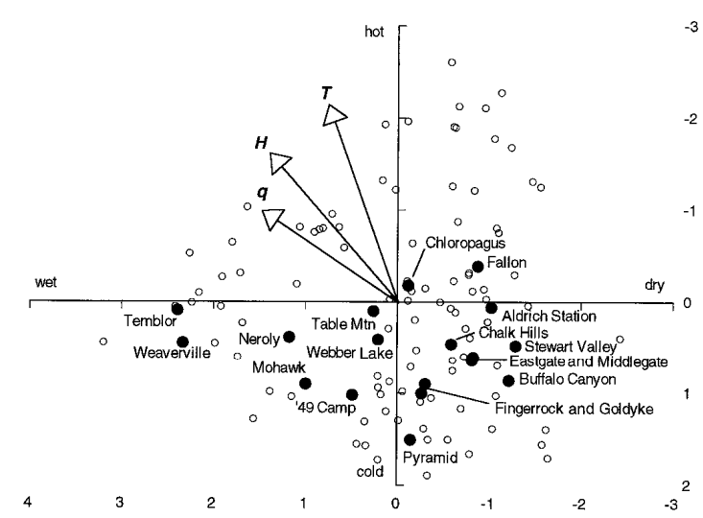
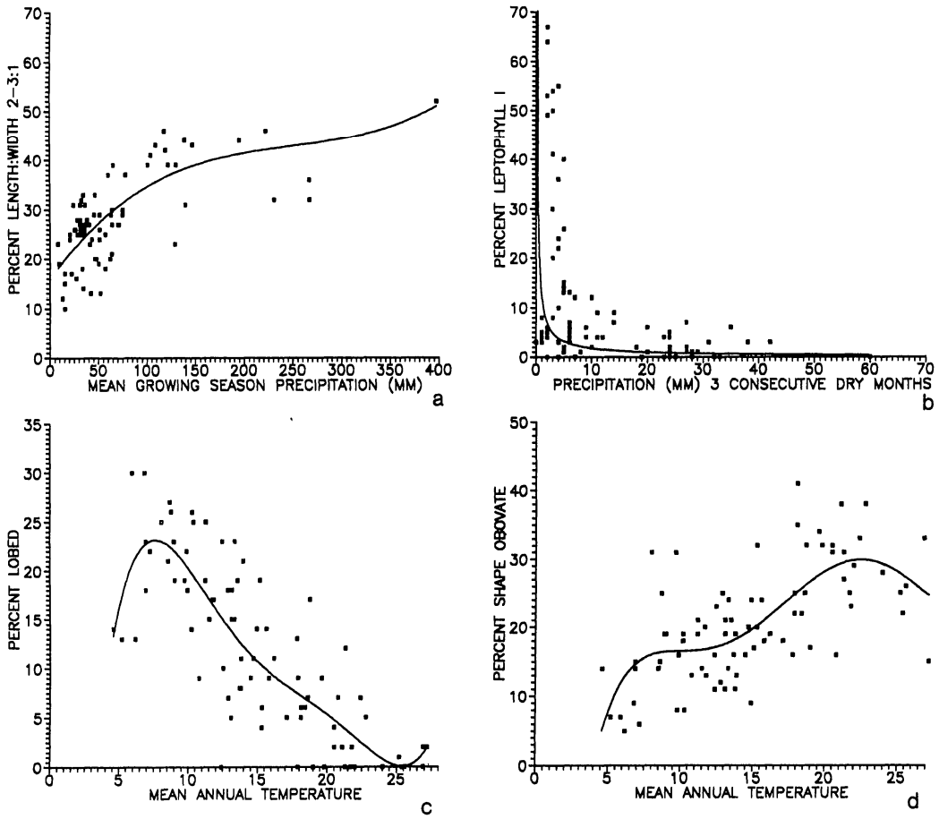
Leaf physiognomy character states to the environmental parameters
Climate-Leaf Analysis Multivariate Program (CLAMP)
Wolfe, 1995
Wet or dry
Hot or cold
T: mean annual temperature
q: specific humidity
H: enthalpy
Notes:
Plot of the canonical correspondence analysis of environmental factors (arrows), modern samples (open circles), and fossil leaf assemblages (solid circles).
Axis 1 (which is shown as vertical here), which explains ;50% of the physiognomic variation, represents temperature factors; whereas axis 2, which explains ;20% of the physiognomic variation, represents water stress.
Both water and temperature controls the three parameters, the direction shows which factor can affect more. The length of the arrows shows how strong the parameters are related to the two factors.
canonical correspondence analysis

Slide 4
Environmental parameters to the paleo-elevation
Observation: Moist static energy (h) is zonally invariant
J/kg or m²/s²
enthalpy
gravitational potential energy
h: moist static energy
c_{p}: specific heat capacity
T: absolute temperature
L_{v}: latent heat of vaporization
q: specific humidity
g: gravitational acceleration
Z: elevation
H: enthalpy
Error of elevation:
σ_{H}：error of the predicted enthalpy
σ_{h}：error from the variation of the h
Notes:
the total energy content
Per unit of mass
work of volume change
Transform liquid gas
canonical correspondence analysis

Slide 5
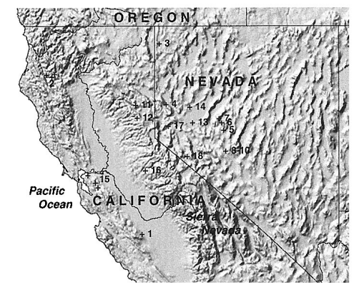
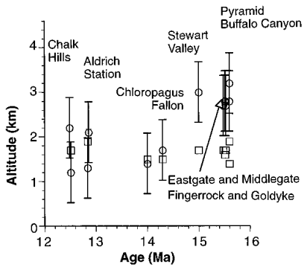
Paleo-elevation
1 to 1.5 kilometers higher than its present altitude
present-day altitudes
Notes:
Analyses of 12 mid-Miocene floras from western Nevada indicate that this part of the Basin and Range Province stood ;3 kilometers above sea level at 15 to 16 million years ago, which is 1 to 1.5 kilometers higher than its present altitude. Much, if not all, of the collapse to present-day altitudes seems to have been achieved by ;13 million years ago. The crust in much of this area has been extended and thinned throughout the past 40 to 50 million years, and the isostatic balance of a thinning crust requires subsidence, not uplift as suggested by previous paleobotanical work.

